Slide 1
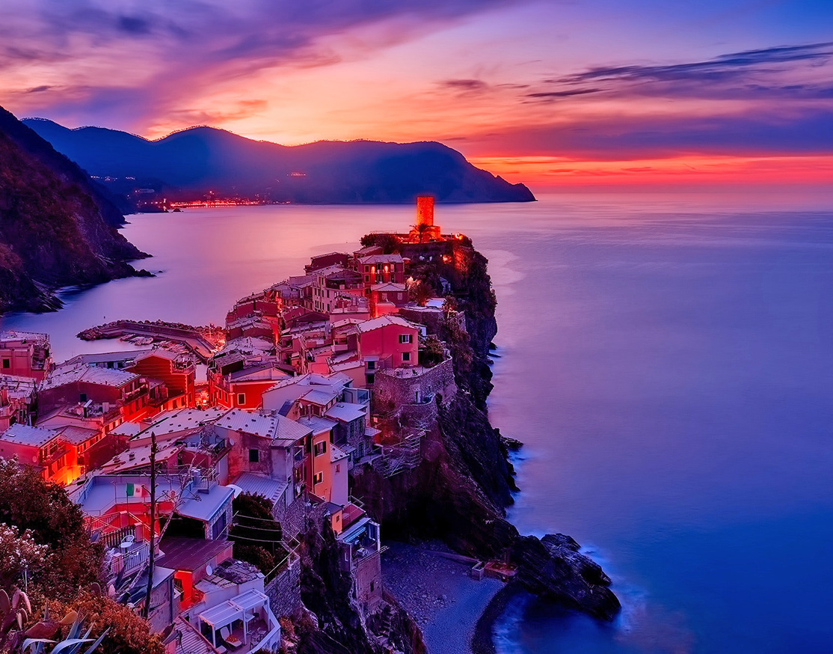
Tourist Place Recommendation
GROUP-3

Slide 2
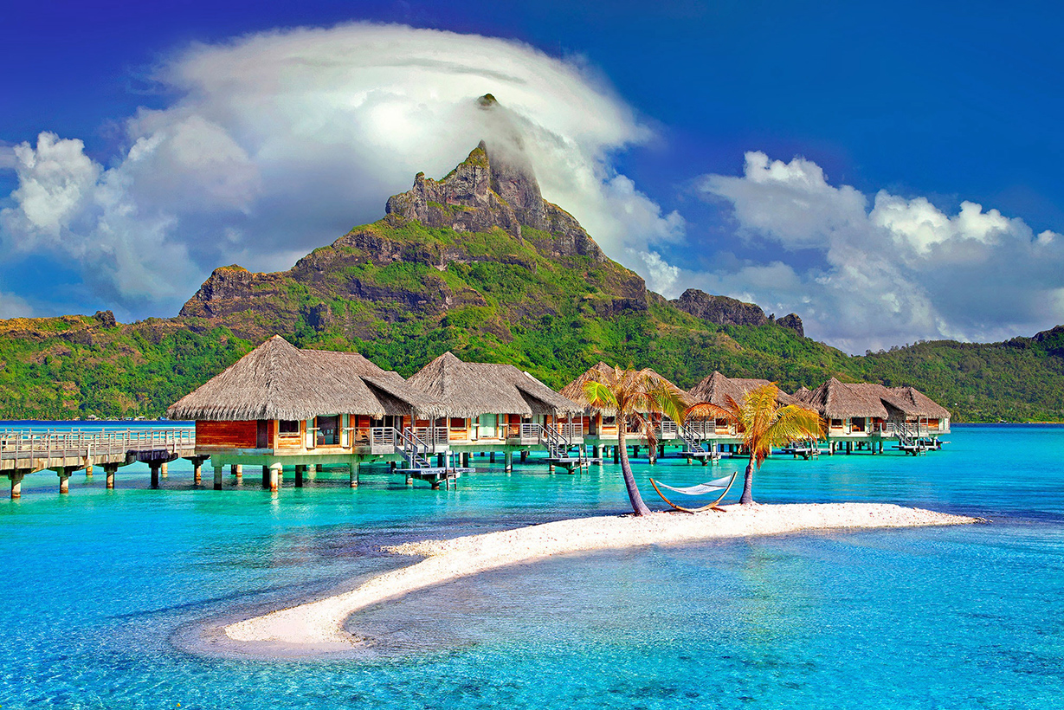
MEMBERS
Hardik Kathuria 20BAI1048
Devanshu Khemka 20BAI1319
Sarvesh Chandak 20BAI1221

Slide 3
LANGUAGES USED
HTML
MongoDB
Node.js
CSS
HTML
CSS
JavaScript
Node.js
MongoDB
JavaScript

Slide 4
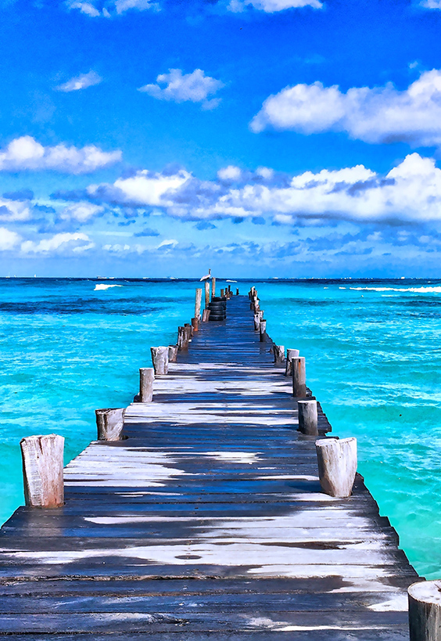
ABSTRACT
This project is based on how an effective travel website will make us feel. It is based on a traveling website with fully-featured functions that will activate the traveling bug with vibrant imagery.
This website contains highlights of some important places along with high-quality photography and allows people to book their dream destination within their budgets. It also includes full customer support, vivid options, the customer can choose for there dream destination according to there age and status, also as per there time choice.
We will also try to include the full virtual tour of place through different videos and images.

Slide 5
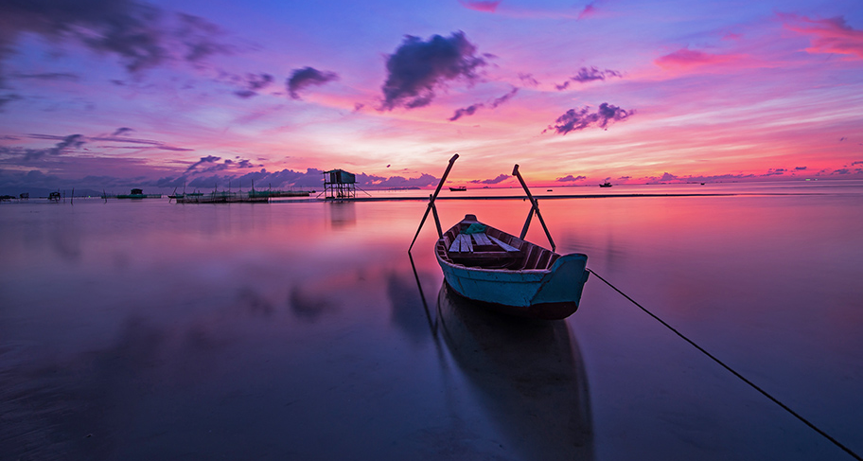
APPLICATIONS/ ADVANTAGES
This website will help tourist to select place on the basis of their personal interest such as types of activities users want to perform, types of places users want to visit, etc.
Everyone gathers inspirations from different mediums and in different ways. But knowing how to activate those creative juices is an important part of being a creative web designer.
When it comes to travel web design projects, scope can quickly narrow down the resources available. So it becomes difficult to find the right inspiration for travel projects.

Slide 6
TIMELINE
 | Working | TIME
REVIEW 1 | Basic Idea | 10/02/2022
REVIEW 2 | Frontend | 10/03/2022
BACKEND | Backend | 03/04/2022
REVIEW 3 | Compilation | 15/04/2022
(Tentative)

Slide 7
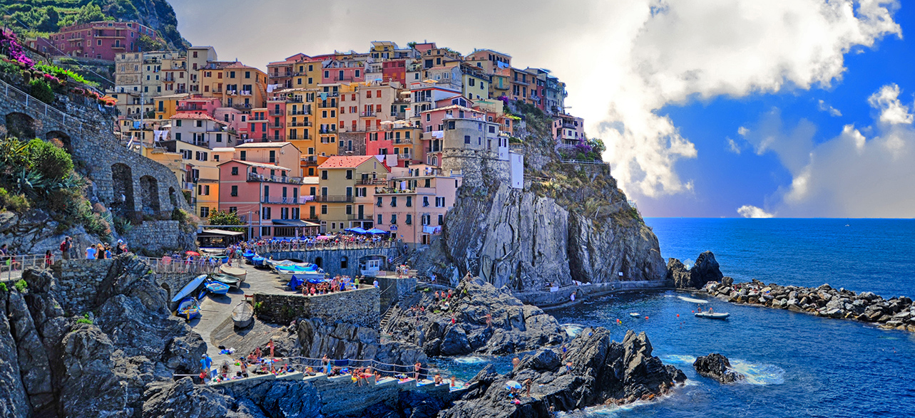
THE BACKGROUND OF OUR WEBSITE

Slide 8
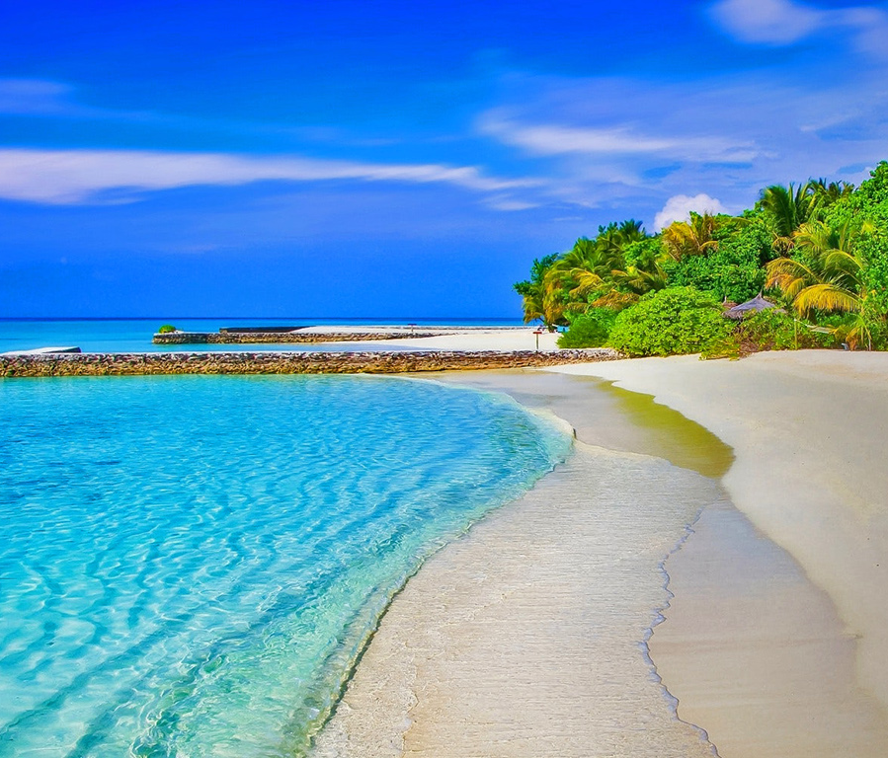
THANK YOU!
CONTACT US AT-
Email:
sarveshsanjay.chandak2020@vitstudent.ac.in
devanshu.khemka2020@vitstudent.ac.in
hardik.kathuria2020@vitstudent.ac.in

